Slide 1
Terraform for Azure

Slide 3
Terraform to Azure Module 02 - Terraform Introduction

Slide 4
Overview
After completing this learning unit, you will understand
What is Terraform?
Install and Configure Terraform
Providers
Files and Directories
HCL (HashiCorp Configuration Language)

Slide 5
What is Terraform?

Slide 6


What is Terraform?
Terraform is an open-source infrastructure as code (IaC) software tool created by HashiCorp.
Terraform allows users to manage and provision infrastructure resources including virtual machines, containers, and other cloud-based resources.

Slide 7
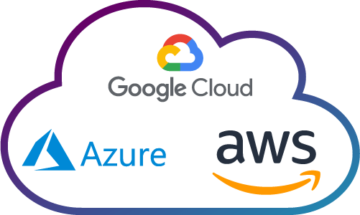
Why use Terraform?
Terraform allows for easy collaboration between teams. Multiple team members can work on the same project without stepping on each other's toes.
Terraform provides a unified way to manage different types of infrastructure.
Terraform can handle working with different cloud providers like AWS, Azure, or on-premise solutions like Vmware.

Slide 8
Terraform is NOT: “Write once, deploy anywhere“
Providers are the libraries for the different vendors
Providers have different settings

Slide 9
How does terraform work?
Terraform is an open-source tool and written in the Go programming language.
The Go code compiles down into a single binary called, Terraform
Terraform gets to leverage the infrastructure cloud providers are already running for their API servers, as well as the authentication mechanisms you’re already using with those providers

Slide 10
How does terraform work?
The Terraform binary has many other subcommands for a wide variety of administrative actions, but these three basic provisioning tasks are the core of Terraform.
Terraform Init
Terraform Plan
Terraform Apply
This command prepare your working directory for other commands. This command performs several key initialization tasks that are necessary for Terraform to operate: Download Provider Plugins, Set Up Backend, Prepare the Working Directory, Initialize Modules.
This command evaluates a Terraform configuration to determine the desired state of all the resources it declares, then compares that desired state to the real infrastructure objects being managed with the current working directory and workspace
This command performs a plan just like terraform plan does, but then carries out the planned changes to each resource using the relevant infrastructure provider's API.

Slide 11
Install and Configure Terraform

Slide 12
Install Terraform
Supported Operating System
macOS
Windows
Linux
FreeBSD
OpenBSD
Solaris
Install the Azure CLI
Update Environment Variables to terraform.exe
Notes:
Install Terraform on Windows with Azure PowerShell | Microsoft Learn

Slide 13
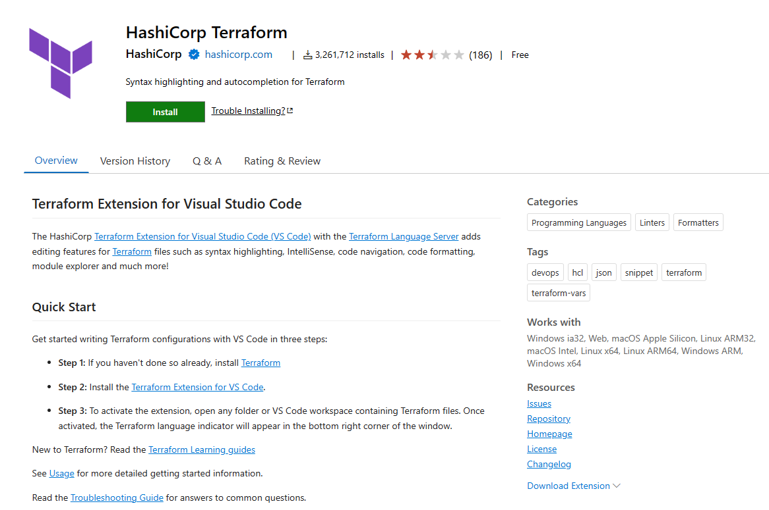
VS Code Extension
IntelliSense
Syntax validation
Syntax highlighting
Code Formatting
Terraform commands Directly

Slide 14
DEMO
Notes:
Show terraform – version
Show environment variable
Show VS Code with Extension

Slide 15
Providers
Notes:
Browse Providers | Terraform Registry

Slide 16
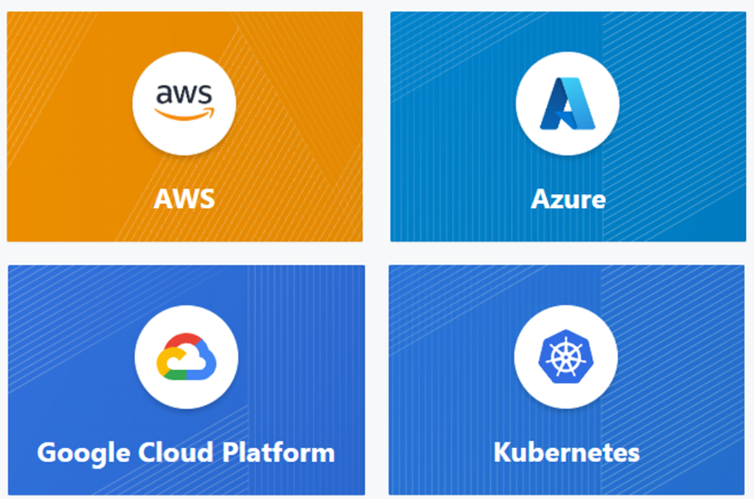
Official Providers

Slide 17
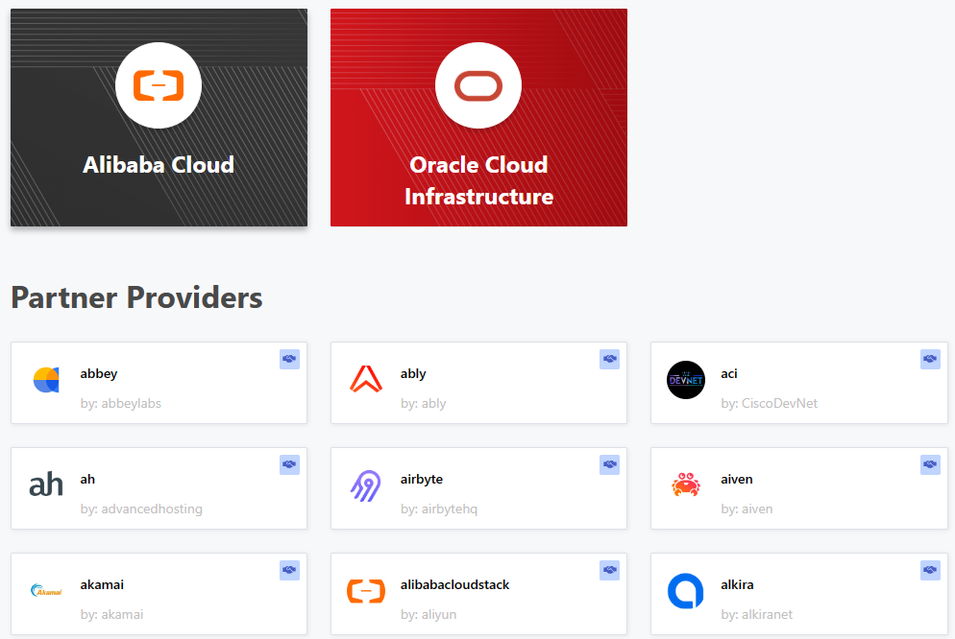
Partner Providers

Slide 18
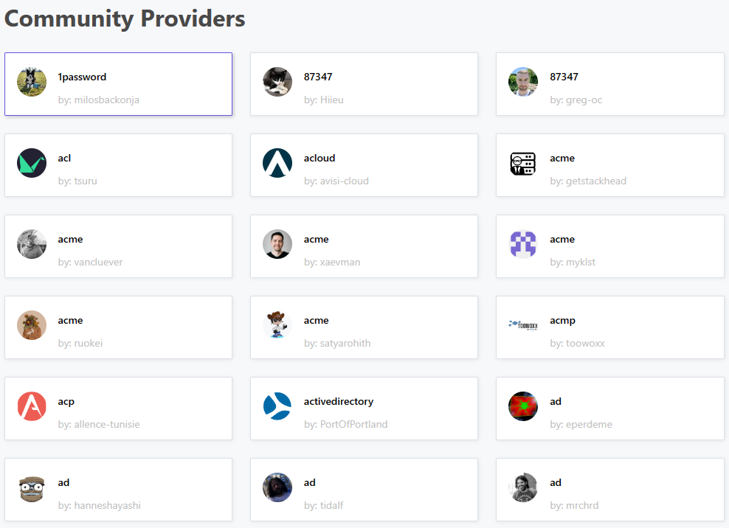
Partner Providers

Slide 19
Files and Directories

Slide 20
File Extension
Code in the Terraform language is stored in plain text files with the ”.tf” file extension
Configuration files must always use UTF-8 encoding
Usually use Unix-style line endings (LF) rather than Windows-style line endings (CRLF), though both are accepted.
Common files
main.tf
variables.tf
outputs.tf
providers.tf
Notes:
Files and Directories - Configuration Language | Terraform | HashiCorp Developer

Slide 21
Working Directory Contents
A Terraform configuration describing resources Terraform should manage. This configuration is expected to change over time.
A hidden .terraform directory, which Terraform uses to manage cached provider plugins and modules. This directory is automatically managed by Terraform and is created during initialization.
State data, if the configuration uses the default local backend. This is managed by Terraform in a terraform.tfstate file.
Notes:
Initializing Working Directories - Terraform CLI | Terraform | HashiCorp Developer

